Slide 1

CRIME DIFFERENCE IN THE WEST MIDLANDS IN AUGUST 2020 VS AUGUST 2021
Group 1 - Hibaa Aldubai, Farah Hayat, Badrija Khalifa, Kazimierz Lubas, Anderson Safo
Notes:
Welcome to group ones group project where we are looking at the crimes committed in the west midlands during the two months of August 2020 and august 2021.

Slide 2
DATA CLEANING
DIFFERENCE IN CRIME NUMBERS
INTRODUCTION
TABLE
OF
CONTENTS
CRIME LOCATIONS
MOST COMMON CRIME TYPE
CRIME OUTCOMES
OUTCOMES & CONCLUSIONS
Notes:
We are going to start off by introducing our topic and what our predictions were before we started our data exploration and how we cleaned our data. We will then go on to answer the following questions, is there a significant difference in the number of crimes across both months? What were the most common crime types and are they the same for both months? What were the different crime outcomes and where these crimes were committed. We will then end on our project outcomes and conclusions.

Slide 3
INTRODUCTION
For this project, we chose to look at crimes within the West Midlands during the month of August across 2020 and 2021. We picked the West Midlands over other regions as that is where most of us live and work.
We wanted to see if the Covid-19 pandemic had an effect on the crime rate.
We predicted that there would be less crimes committed in 2020 due to most of the population either working from home or on furlough which meant that there were less people in public and therefore less crime. There were also stricter lockdown laws and many people were still following government recommendations to stay at home compared to 2021 were the rules were more relaxed.
Notes:
If I were to ask you about 2020 and 2021, I’m sure for most of us the covid-19 pandemic will be the first thing to come to mind. It impacted all of us in many different ways from how we work through to our personal lives, global economics, spending habits etc etc. In our project we decided to check whether the pandemic also influenced crime rate in the west midlands specifically looking at the month of August in 2020 and 2021.
We predicted that there would be less crimes committed in 2020 due to most of the population either working from home or on furlough, which meant that there were less people in public and therefore less crime. There were also stricter lockdown laws and many people were still following government recommendations to stay at home compared to 2021 were the rules were more relaxed.

Slide 4
DATA CLEANING
We obtained our data from https://data.police.uk/docs/ - API documentation.
We downloaded 2 CSV files for 2 months that we decided to focus on: August 2020 ("2021-08-west-midlands-street") - 12 columns, 28,452 rows August 2021 ("2021-08-west-midlands-street") - 12 columns, 32,096 rows
Both data frames were then merged into one to create a large dataframe with 12 columns and 60,548 rows.
We then cleaned the dataframe by removing 7 columns that contained information we didn’t find useful and dropped the rows that contained empty cells.
The final dataframe contained 7 columns and 53,090 rows with each row representing a different crime.
Notes:
We started off by obtaining our data from data.police.uk- API documentation.
We downloaded 2 CSV files which contained the crime data from August 2020 and August 2021 reported by the west midlands police.
We then imported our data and put them into dataframes using Pandas.
Both files contained a large amount of data with roughly 30,000 rows each across 12 columns.
After merging both data frames, removing unwanted columns and removing rows which contained empty cells, we were left with our final dataframe that had approximately 53 thousand rows and 7 columns and is what we used to perform our data exploration.
53000 crimes in 2 months comes to just under one thousand reported crimes each day, I think we’ve all picked the wrong area to live in.

Slide 5
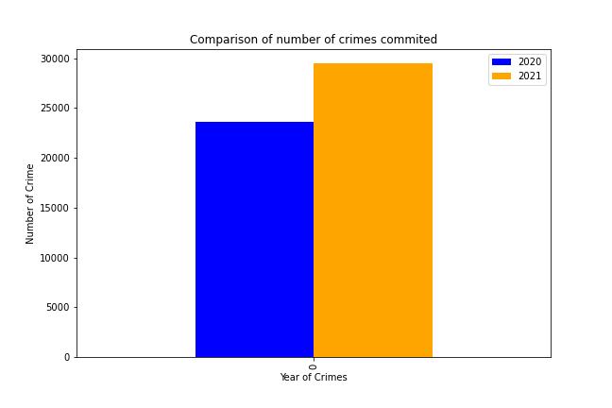
DIFFERENCE IN CRIME NUMBERS
Fully recorded crimes in August 2020: 23,644
Fully recorded crimes in August 2021: 29,446
Notes:
Our first question is: is there a difference in the total number of crimes between these 2 months?
If you take a look at this bar chart, you can easily tell in which year were the most amount of crimes committed.
2021 saw an increase of 25% in crimes committed compared to 2020.
To get the total number of crimes for each year, we locked the dataframe for 2020 and 2021 and counted the values by “Crime ID”.
This was unique for each crime.
The results were then placed in a new data frame and this bar chart was created for easy visualisation.

Slide 6
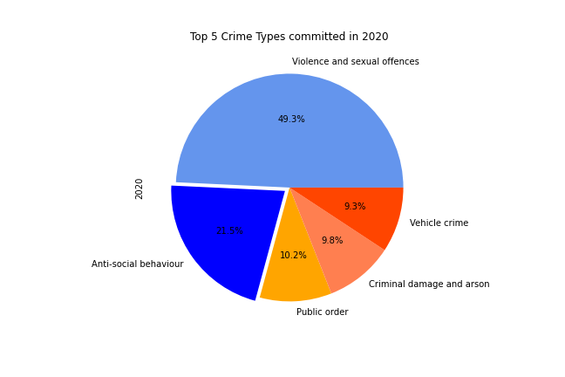
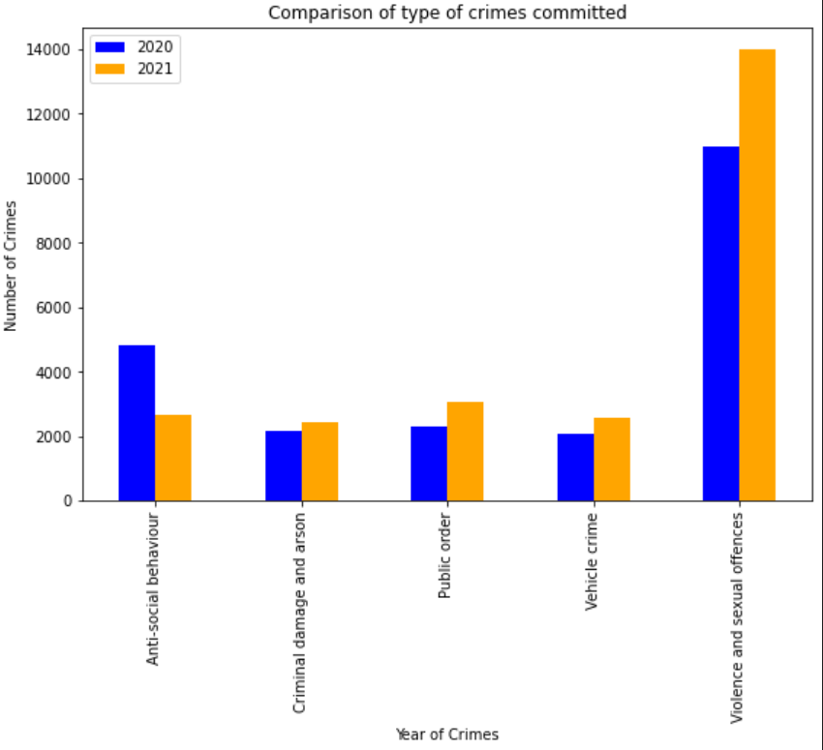
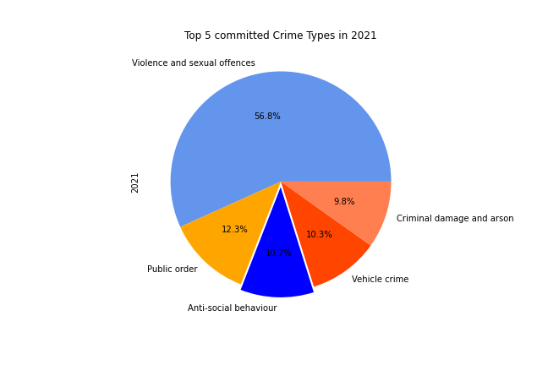
TOP 5 TYPES OF CRIMES COMMITTED
Notes:
Our second question is: what are the top 5 types of crime and if the same trend is observed in specific types of crimes across both months?
As the crimes were grouped into so many categories, we selected the top 5 for each year for further comparison and analysis.
In order to find the top 5, we created a new dataframe by locking by “month” and grouping by “crime type”. This consisted of three columns, the type of crime and the years 2020 and 2021.
The results were then added to a new data frame for simplicity in building new visualisations.
The bar chart on the right shows the top 5 crime types: “anti-social behaviour, criminal damage and arson, public order, vehicle crime, and violence and sexual offences”.
And on the right we have them displayed in piecharts with 2020 at the top and 2021 below. The percentages displayed are the percentages of each crime type in the top 5 rather than as a percentage from the total crime amount.

Slide 7
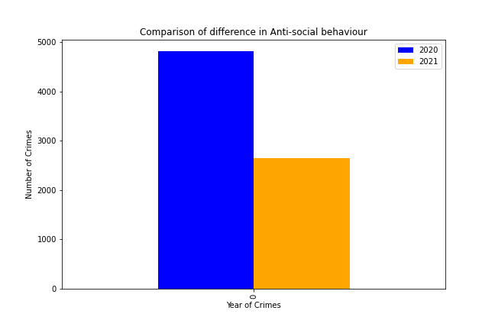
ANTI-SOCIAL BEHAVIOUR
Notes:
Even though violence and sexual offences had the gratest gap between both months, anti-social behaviour crimes were the only category where the number of crimes actually decreased from 2020 to 2021. this was by about 50% .
This might have been caused by frustration or boredom that many people felt in 2020 during the lockdown, but we are only data analysts and not social experts so we can only assume.

Slide 8
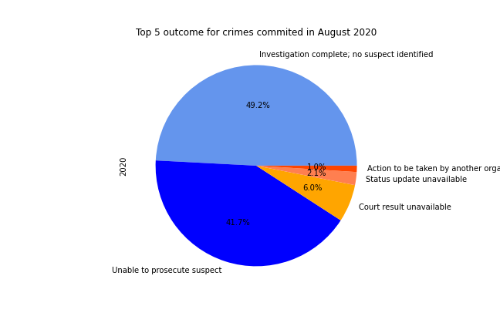
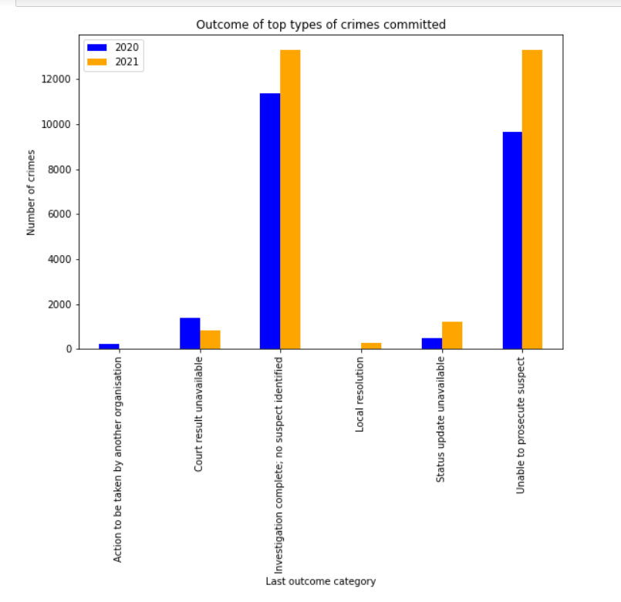
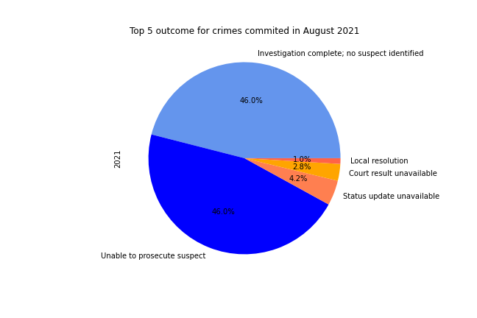
TOP CRIME OUTCOMES
Notes:
Next we decided to look at the outcomes of all these crimes and if there were any changes during both years.
It was very concerning to see that in August 2020, around 89% of reported crimes ended up as either “Unable to prosecute suspect” or “Investigation complete; no suspect identified”. For 2021 that slightly increasesd to 90%. You can see this presented on the pie charts on the left with 2020 at the top and 2021 below.
The bar chart on the right presents the same outcomes this time side by side for easier comparison.

Slide 9
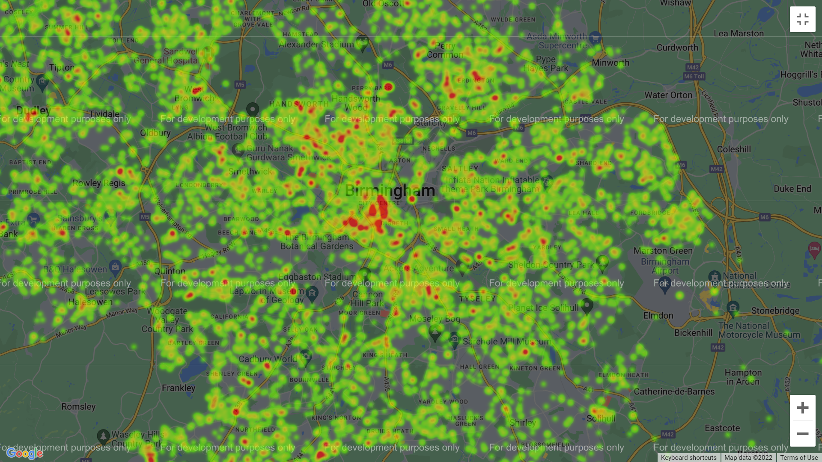
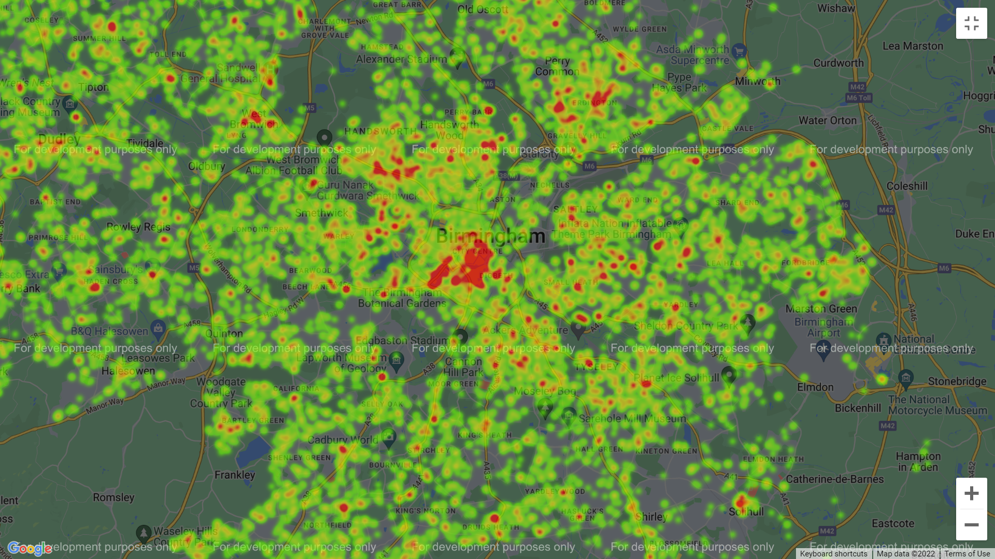
LOCATION OF TOP 5 CRIMES IN BIRMINGHAM
2020
2021
Notes:
We next look at where the crimes were committed and if there are any specific hotspots?
As predicted, Birmingham town centre appears to be the most attractive area for criminals across both years.
Going by these heatmaps, if youre looking to move areas… we recommend leaving Birmingham, but if you insist on staying, there is a nice clean patch here around the edgbaston cricket ground which looks fairly safe, which funnily enough is where I used to live. I however moved to erdington not long ago… and looking at these, I don’t think that was a wise decision.
We only plotted the top 5 types of crime as unfortunately if I had left all of them in, the heatmap would look something along the lines of this.

Slide 10
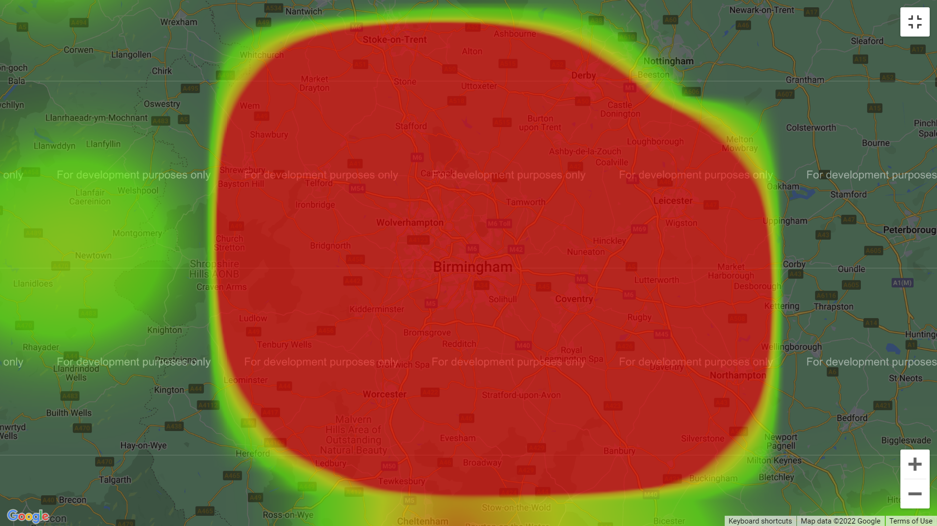

Slide 11
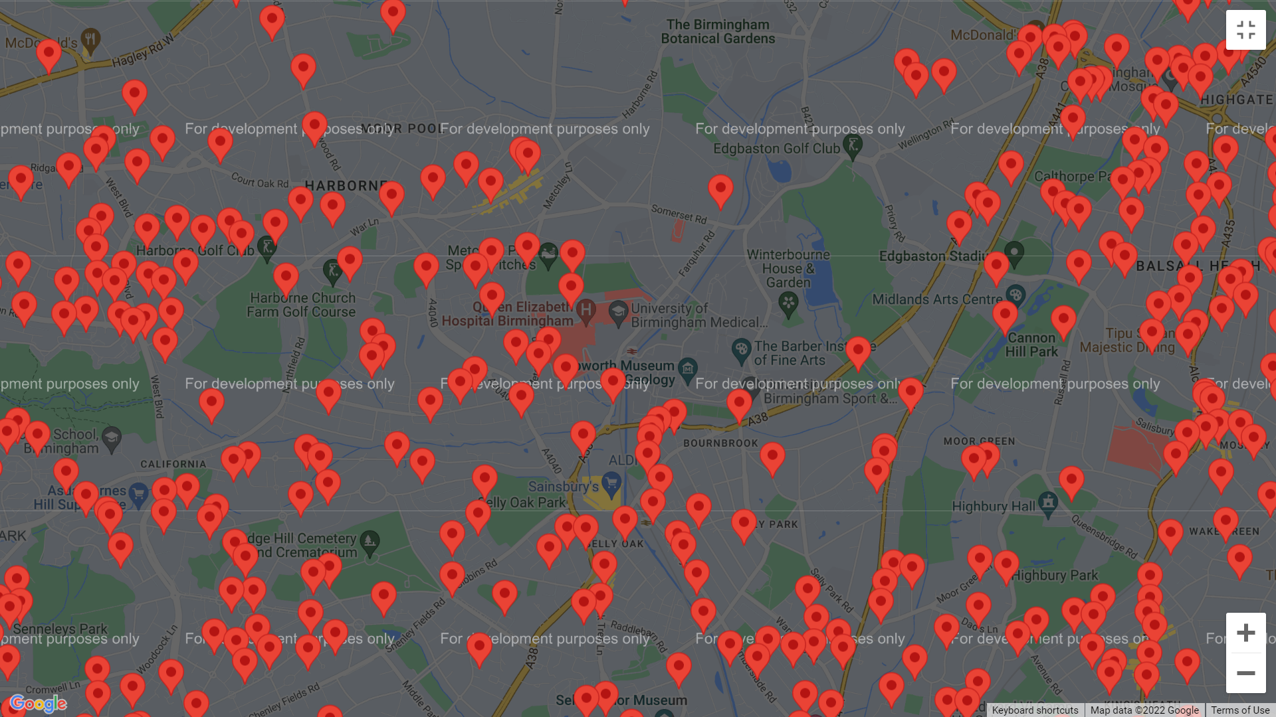
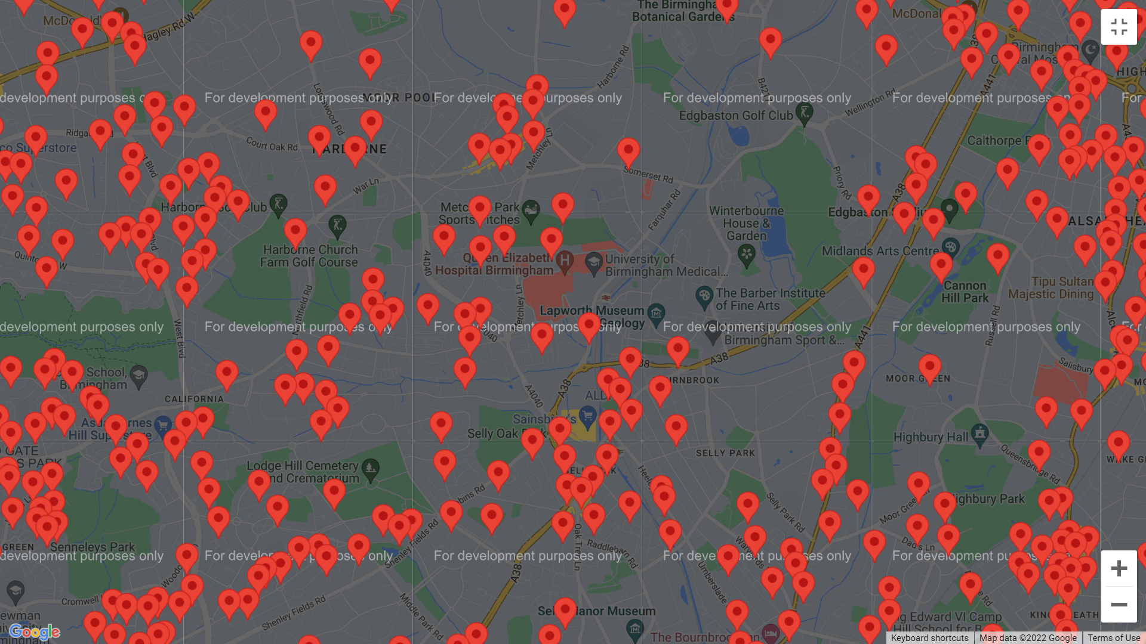
VIOLENCE AND SEXUAL OFFENCES
University of Birmingham
2020
2021
Notes:
We thought it would be interesting to look at the most popular crime type “violence and sexual offences” and to see where these crimes were committed specifically looking at the university of Birmingham and surrounding areas of Birmingham. We can see there is a slight increase in 2021 compared to 2020.

Slide 12
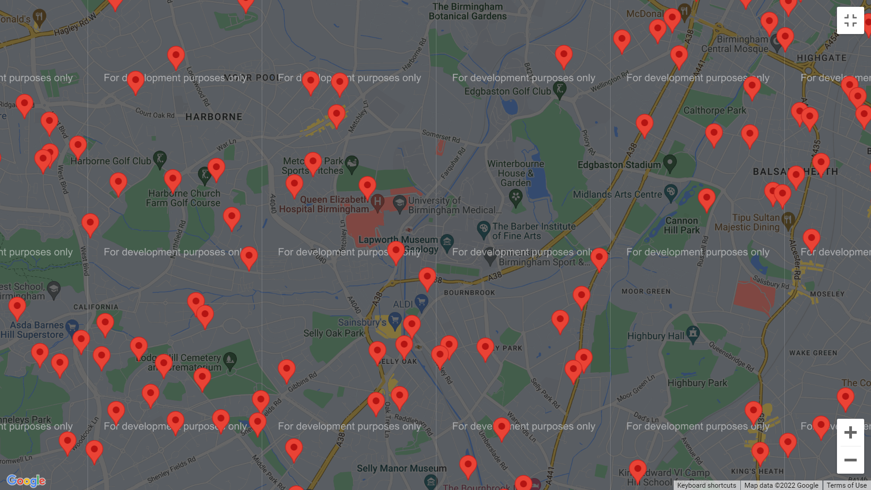
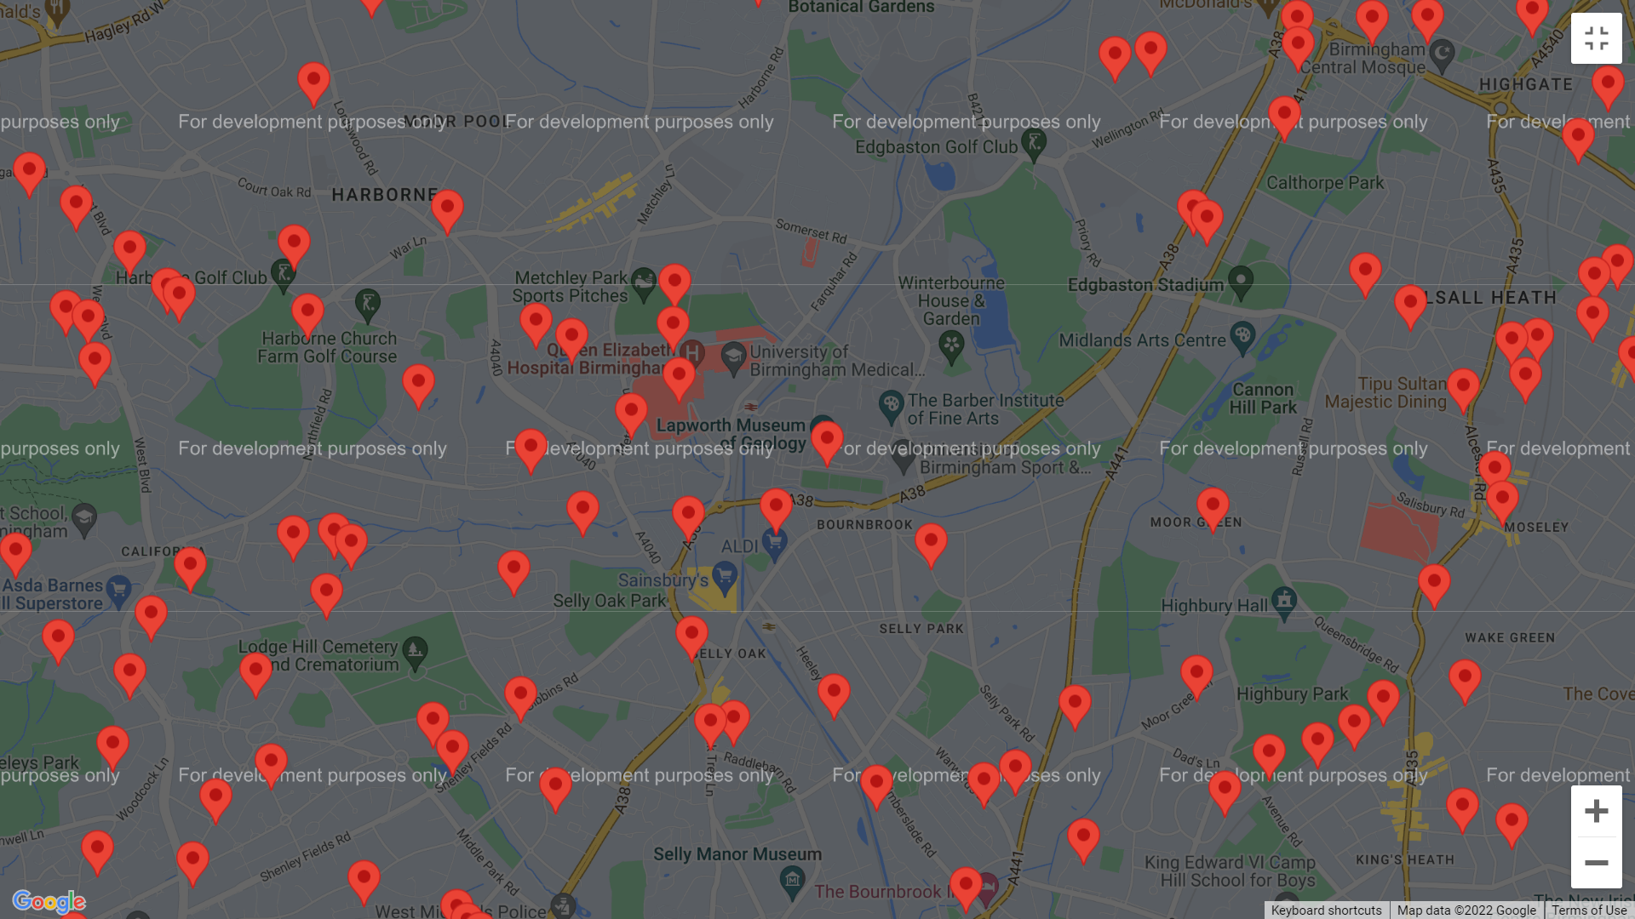
ANTI-SOCIAL BEHAVIOUR
University of Birmingham
2020
2021
Notes:
We also thought it would be interesting to look at where the anti-social behaviour crimes were reported, also focusing at the area around the university of Birmingham as this was the only crime type which decreased from 2020 to 2021.

Slide 13
OUTCOMES AND CONCLUSIONS
There is a noticeable increase in the number of crimes in 2021 compared to 2020. This could’ve been as a result of the Covid-19 pandemic and the laws and regulations enforced at the time but there may have been other contributing factors as well.
In 2020 many people were furloughed or made redundant and as a result spent more time at home.
Many people were still unsure about Covid-19 and there were stricter rules on masks and social distancing. These were more relaxed in 2021.
In 2021 furlough payment also stopped which could’ve resorted in more crime being committed.
The “Eat Out to Help Out” scheme, which happened in August 2021, may have also had an effected on the number of crimes.
Notes:
So as we can see there was a noticeable increase in the amount of crimes committed in 2020 compared to 2021 which is what we had predicted.
We can only assume this was because of the covid-19 pandemic and the effects it had on individuals, the community, organisations and the country as a whole. The effect of people being furloughed, made redundant, working from home, not going to school and not socialising as much could have resulted in the crime difference we have seen.
We hope you have enjoyed our presentation and we now welcome any questions.

